Slide 1
FRAUD DETECTOR
CRISP-DM
Data Science Academy Telkomsel
GROUP K
ANDI BUWONO
RIZALDY AL KAUTSAR WAHYU SEJATI R

Slide 2
CRISP-DM
FRAUD DETECTOR
01
04
02
05
03
06
Business Understanding
Modelling
Understand objective and requirement from business perspective
Building the model for desired output
Data Understanding
Evaluation
Getting familiar with data to form hypotheses
Assess the quality of the model based on requirement
Data Preparation
Deployment
Construct dataset from raw data
Put the result to work and achieve the goals

Slide 3
BUSINESS UNDERSTANDING

Slide 4
BUSINESS UNDERSTANDING
BACKGROUND
TERMINOLOGY
Credit Card Issuer loacted in North Americe have 1.7% Fraud by Transaction and 3.3% by Amount
Business loss can be prevented by detect more accurate Fraud Detector
Fraud Transaction is one that unauthorized by the credit card holder
TRUE = Fraud Transaction
FALSE = Valid Transaction
OBJECTIVE
TOOLS AND TECHNIQUE
Build Fraud Prevention API that can prevent and label possible Fraud Transaction with minimum 80% AUC
Jupyter Notebook & Python for Training Models
XGBoost as algorithm
Tableau for Visualization
Deploy in flask apps

Slide 5
KEY RESULT
80%
2%
20%
AUC
(Area Under the Curve)
An evaluation metric that considers all possible classification thresholds.
Business Success
Fraud Prevented
Growth of Income from less fraud in transaction
Rate of successfully prevented fraud (Recall)

Slide 6
REQUIREMENT & TIMELINE
REQUIREMENT
ASSUMPTIONS
-
Data of CC Transaction across North America Merchant in 2016
CONSTRAINT
TIMELINE
Minimum 80% AUC to pass and have a good prevention of fraud
1 week of data preparation until MVP (Minimum Viable Product) deployement

Slide 7
DATA UNDERSTANDING

Slide 8
DATA UNDERSTANDING
INITIAL DATA
Data of Credit Card Transaction within 2016 in North America Country
Target = “isFraud” (true: fraud, false: valid) which tagged on transaction basis
Data contains account information (id, card number, cvv, apply location), transactions details (date, amount, merchant and location)
DATA DESCRIPTION
Dataset with JSON format with 642k rows and 29 columns
Columns consist of 9 categorical data, 3 boolean, and 17 numerical

Slide 9
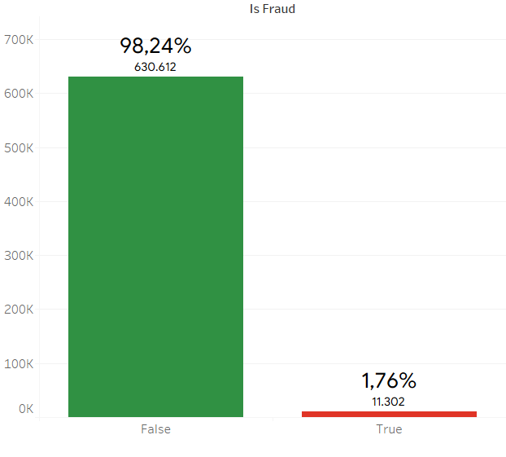
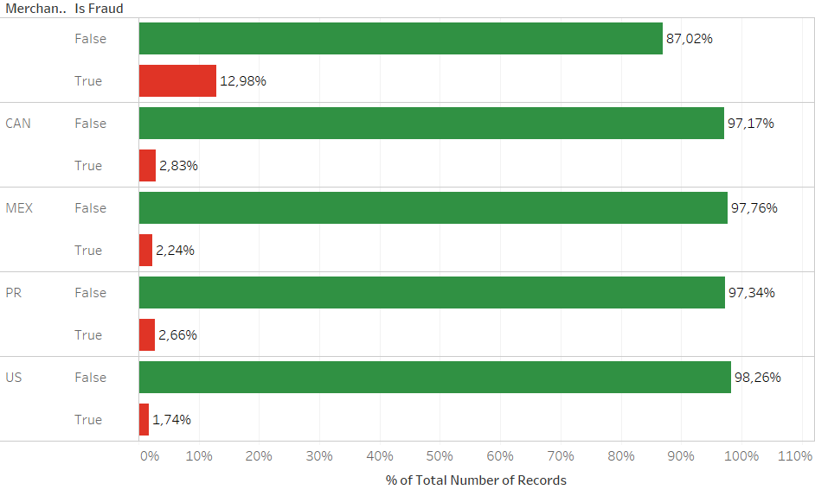
DATA EXPLORATION
Total Fraud in Dataset
Fraud % per Merchant Country

Slide 10
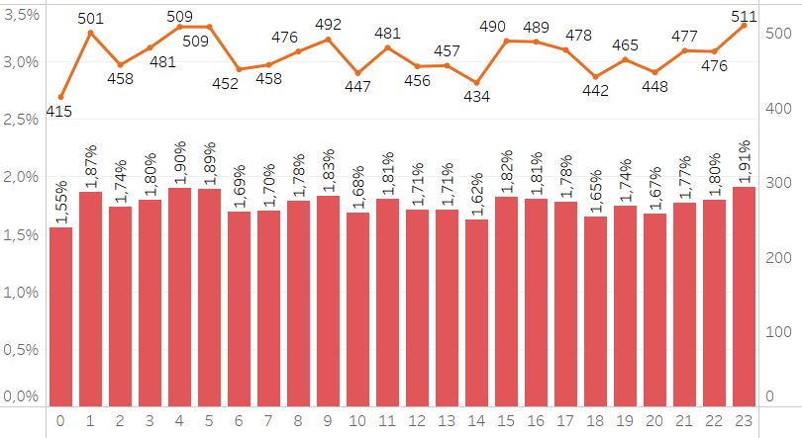
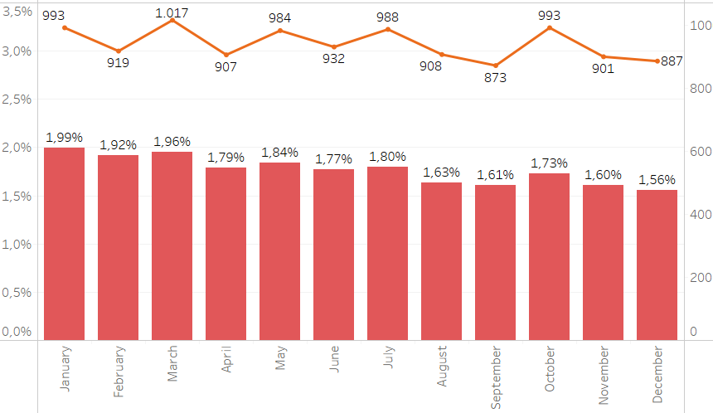
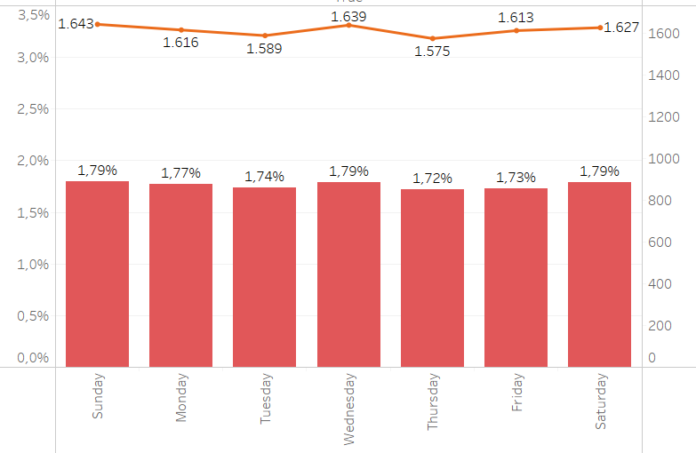
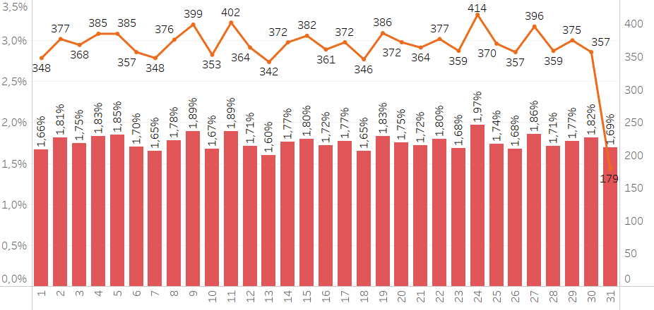
DATA EXPLORATION
Hourly
Month
Weekday
Day

Slide 11
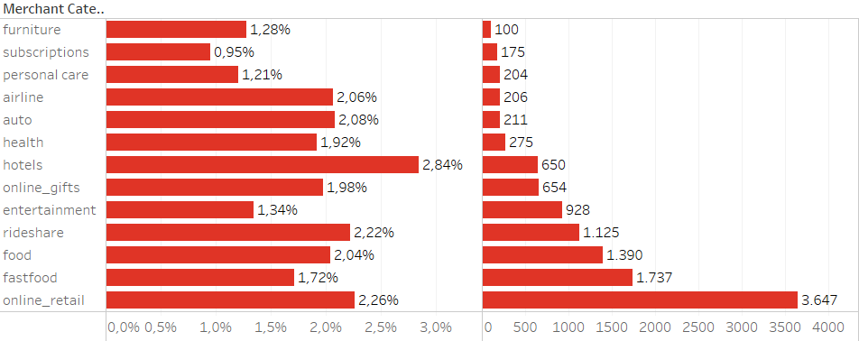
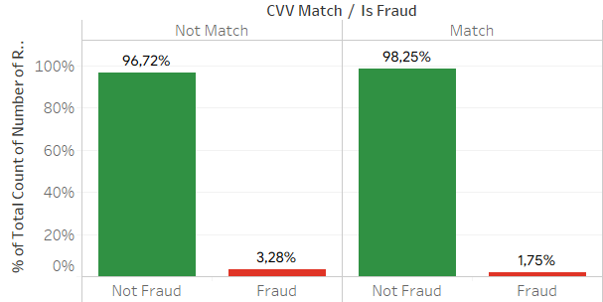
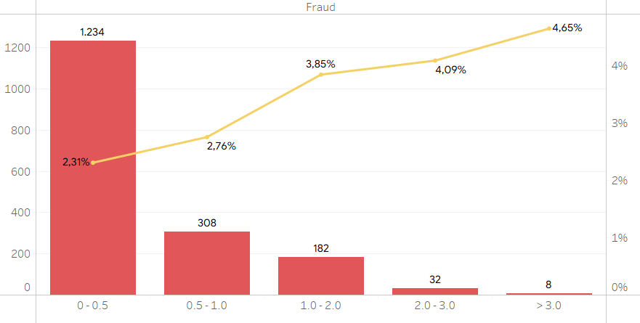
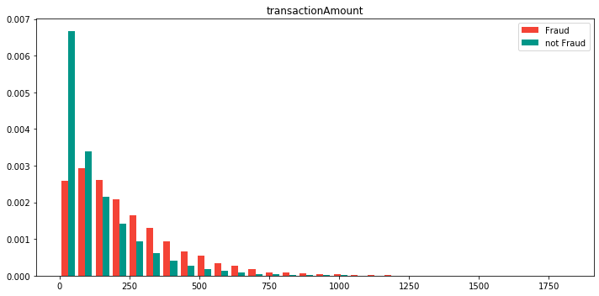
DATA EXPLORATION
Merchant Code
CVV Match
Transaction/Credit Limit
Transaction Amount

Slide 12
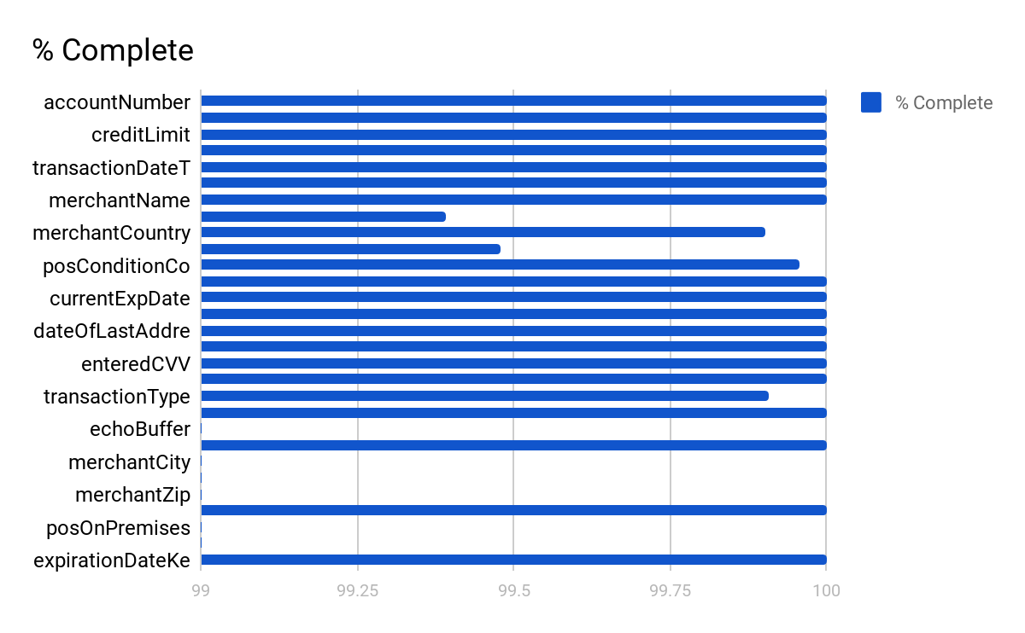
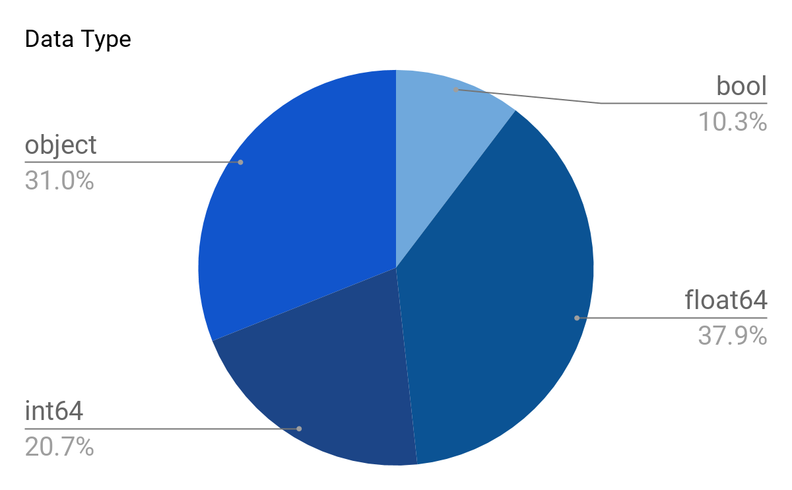
DATA QUALITY REPORT
Column Completion Rate
Column Data Type

Slide 13
DATA
PREPARATION

Slide 14
Data Preparation
Feature Engineering
Extract additional feature such as:
Transaction month
Transaction days of week
Transaction hour
Number of days between transaction and card expiration
Number of days between card registration and transaction
Number of days between card registration and address change
Whether the entered CVV is correct
Whether it’s international transaction or local transaction
One Hot Encoding
Perform one hot encoding on the following features:
acqCountry
merchantCountryCode
transactionType
posEntryMode
posConditionCode
merchantCategoryCode

Slide 15
Data Preparation
Feature Exclusion
Feature Normalization
Exclude the following feature:
echoBuffer: missing value
merchantCity: missing value
merchantState: missing value
merchantZip: missing value
posOnPremises: missing value
recurringAuthInd: missing value
accountNumber: ability for new costumer
customerId: ability for new costumer
transactionDateTime: no reoccurence
currentExpDate: already engineered
accountOpenDate: already engineered
dateOfLastAddressChange: already engineered
merchantName: too much unique values
Apply robust scaler on the monetary feature such as:
creditLimit
availableMoney
transactionAmount
currentBalance
Incomplete Data
All feature with missing value are categorical, we flag is as nan in the one hot encoder
Oversampling
Oversampling the fraud data while maintaining the underlying distribution using SMOTETomek.

Slide 16
DATA
MODELLING

Slide 17
Modeling
Techniques
Parameter
Supervised Learning - XGBoost
We used hyperopt to search best hyperparameter, below:
{'bagging_fraction': 0.42125209181922985,
'colsample_bytree': 0.6604000269557071,
'feature_fraction': 0.6521631863919439,
'gamma': 0.010123197853081717,
'learning_rate': 0.013224200479398276,
'max_depth': 13.0,
'min_child_samples': 200,
'num_leaves': 110,
'reg_alpha': 0.23568010861071798,
'reg_lambda': 0.17200619646922866,
'subsample': 0.8}
Assumption
Dataset is very imbalance (98:2).
We used SMOTE algorithm to oversampled the fraudulent transaction
We assumed data is valid and completeness for new data is similar to dataset
Model Descriptions
Testing Design
XGB model is trained using data after is oversampled using SMOTE, but score is calculated using original data distribution
30% as test and 70% as training

Slide 18
EVALUATION

Slide 19
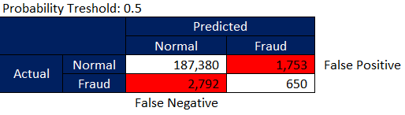
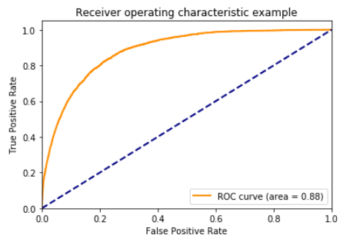
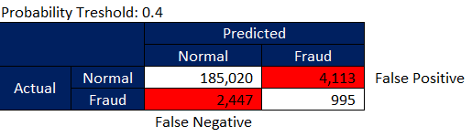
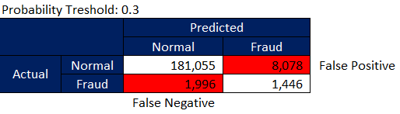
Evaluation
Result Evaluation
Confusion Matrix
Model AUC Score 88% on original test data (without oversampling).

Slide 20
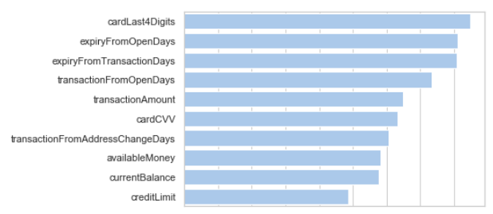
Evaluation
Feature Importance
Next Step
Top 10 Most Important features
Adding recency to increase model accuracy by calculating timedelta between current transaction with previous transaction.
Adding frequency feature with time window 1 hour since current transaction time to detect multiple attempt in a short period.
Final Result vs Target
 | TTarget | Result
Fraud Obtained | 95% | 98.5%
AAUC | 80% | 88%
Revenue Growth | 2% | 3%

Slide 21
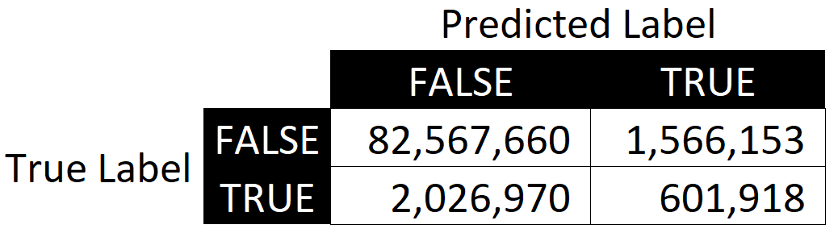
Evaluation
Business Evaluation
AUC of 88% and Fraud recall arround 24%
Assume 1 % payment fee and 15 % interest rate, a potential revenue loss of 0.250 Million
Unrealized transaction
1.566 Million
>
A Net Save of
0.350 Million
(3% of revenue*)
Prevented Loss
0.601 Million
Fraud Loss
2.629 Million
* [total non fraud transc.] x 16% - [total fraud transc.]

Slide 22
DEPLOYMENT

Slide 23
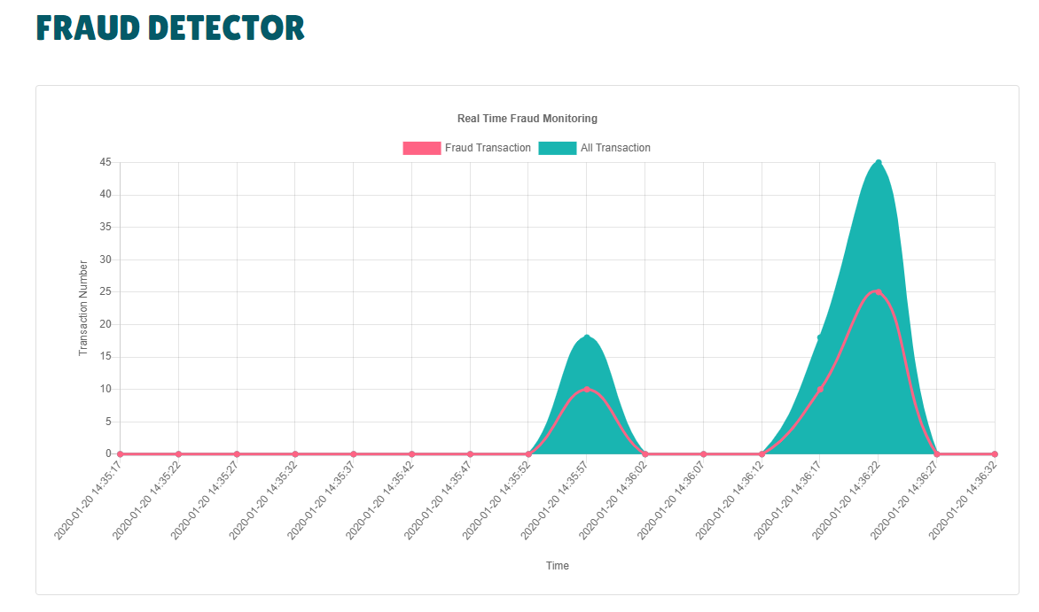
Deployment
Deployment Plan
Monitor and Maintenance
We will use AGILE methodology
We will deploy this as Flask web service in secure environment (login is not needed)
Designed infrastructure
- We will always monitor actual fraud rate and periodically for precision and recall (according to customer dispute of a transaction)
- The monitoring are automated
Monitor
Customer DB
Fraud Transaction
Data enrichment
Fraud Detector
REST: JSON
Payment Gateway
JSON:
isFraud
Fraud probability

Slide 24



OUR TEAM
Andi Buwono
Rizaldy Al Kautsar
Wahyu Sejati R.

Slide 25
THANK
YOU
Please keep this slide for attribution.

